Slide 1
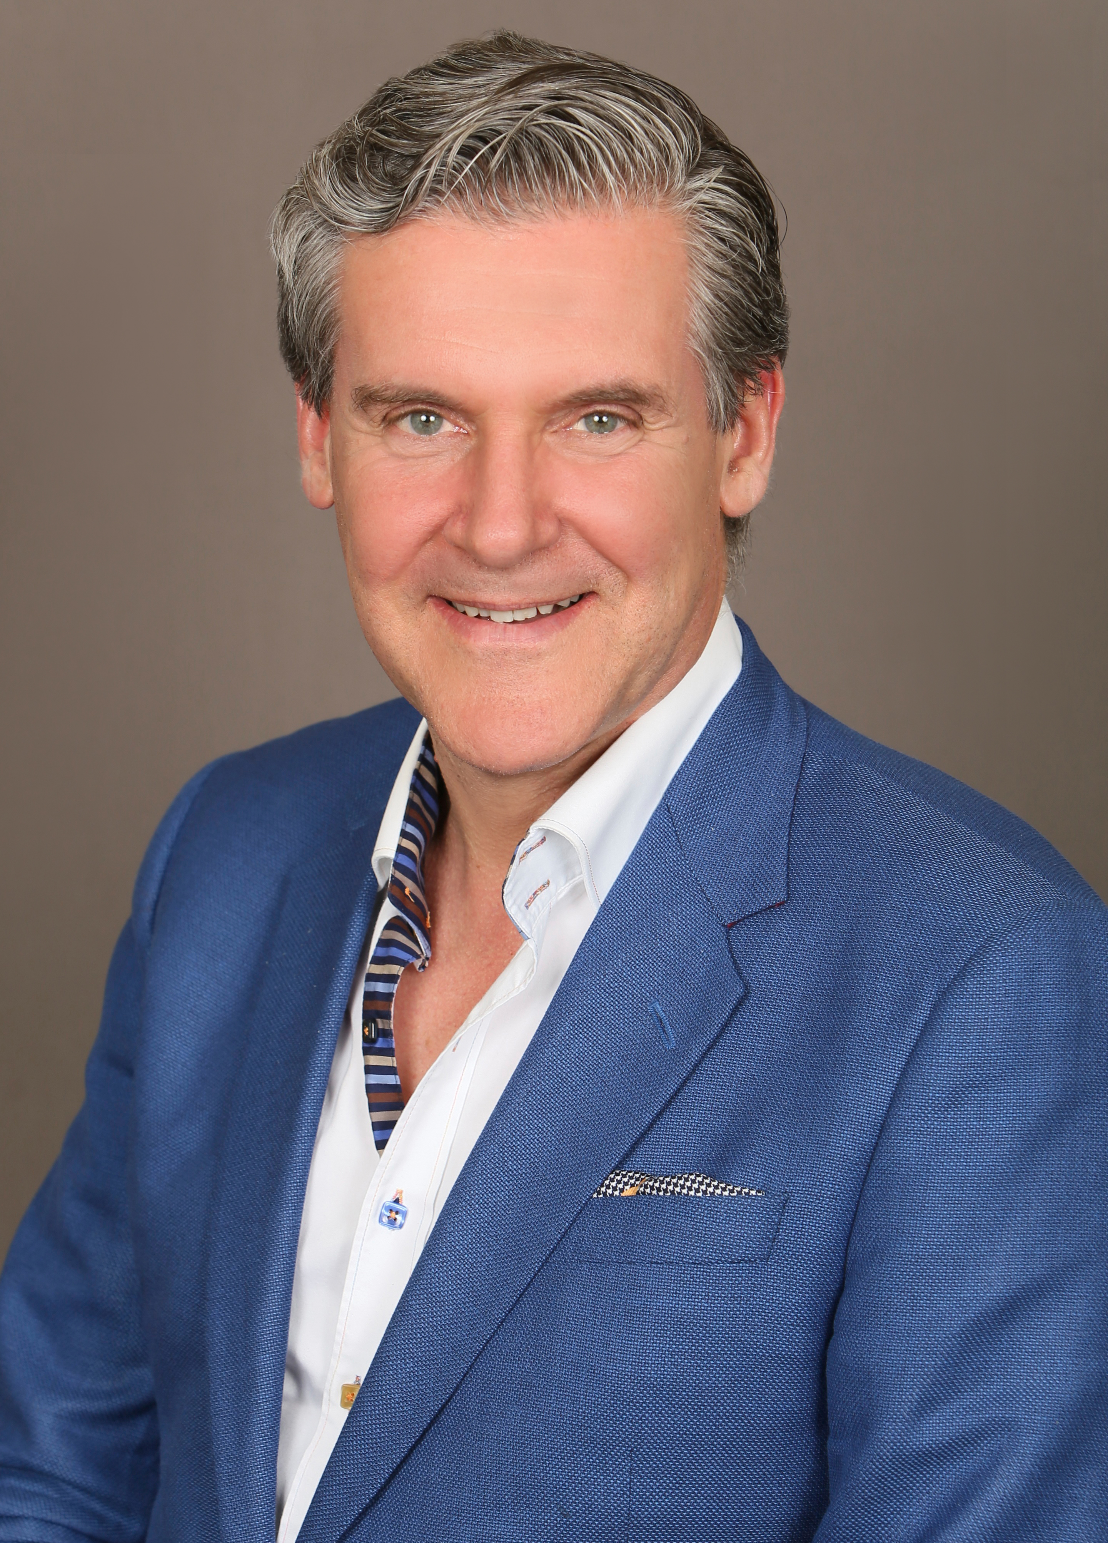
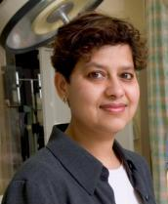
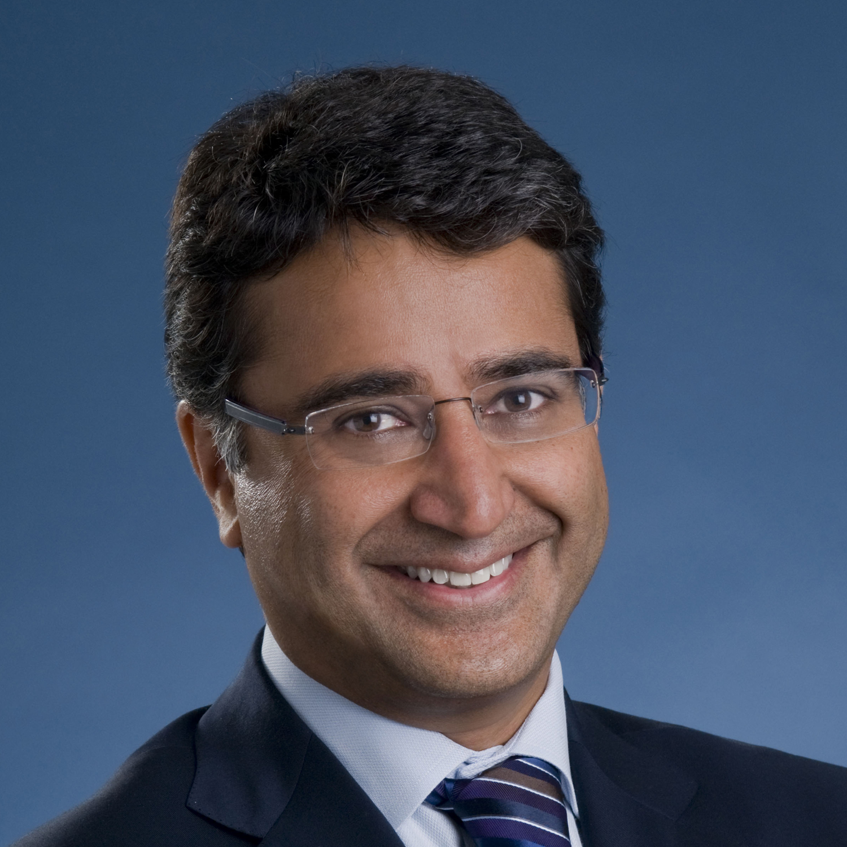
EXECUTIVE COMMITTEE 2018
Avery Nathens
Ori Rotstein
Chair
Departmental Appointments Committee
Associate Chair
Michael Fehlings
Robin McLeod
Vice Chair, Research
Vice Chair, Best Practices
Najma Ahmed
Shaf Keshavjee
Robin Richards
Vice Chair, Education
Vice Chair, Innovations
Vice Chair, Clinical

Slide 2
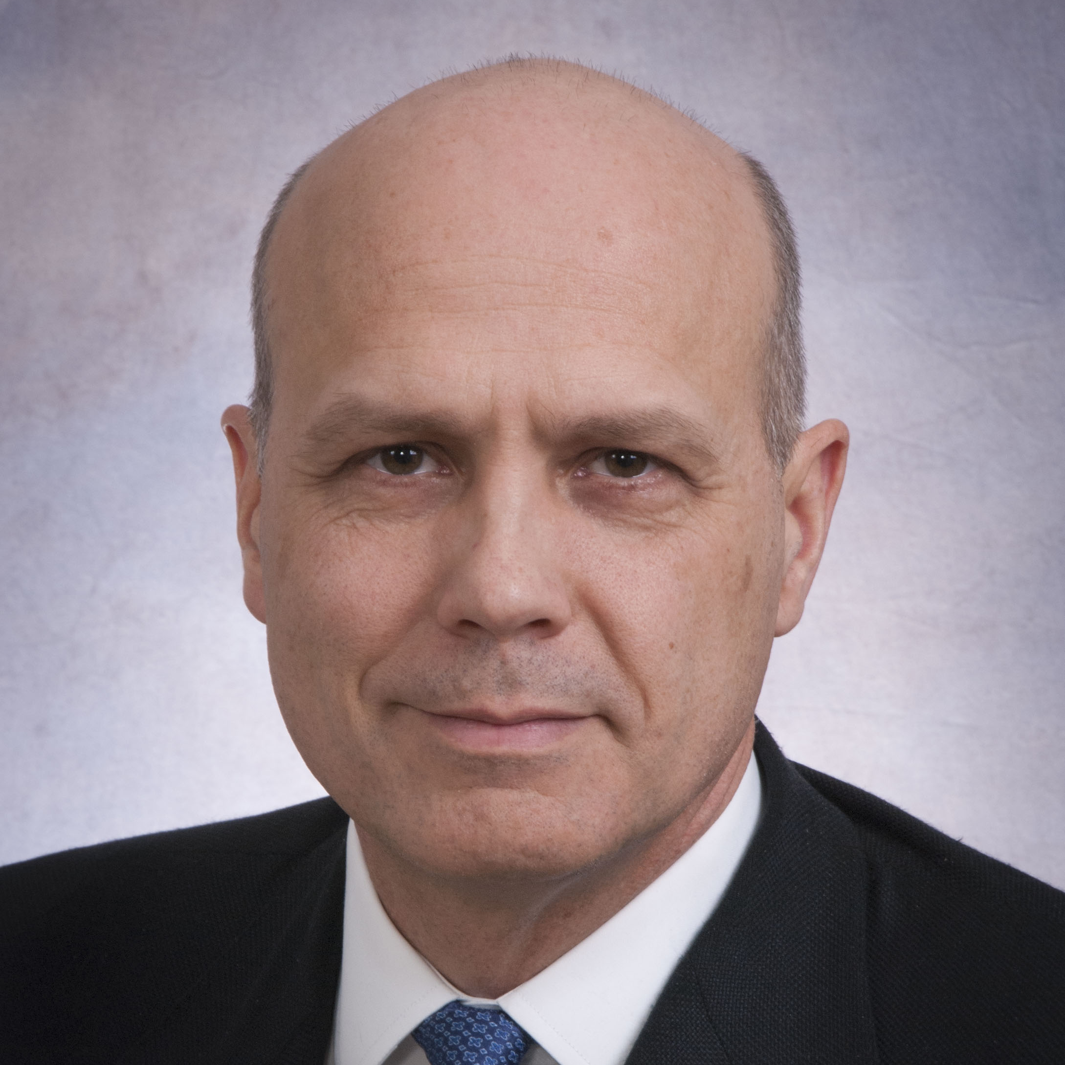
Division chairs 2018
Cindi Morshead
Carol Swallow
Peter Ferguson
Anatomy
General Surgery
Orthopaedics
Glen van Arsdell
Andres Lozano
Cardiac Surgery
Neurosurgery

Slide 3
division chairs 2018 continued
Chris Forrest
Tom Waddell
Neil Fleshner
Tom Forbes
Plastic & Reconstructive Surgery
Thoracic Surgery
Urology
Vascular Surgery

Slide 4
Surgeon-in-chiefs 2018
Jay Wunder
Ori Rotstein
Avery Nathens
Shaf Keshavjee
Mount Sinai Hospital
St. Michael’s Hospital
Sunnybrook Health Sciences Centre
University Health Network

Slide 5
surgeon-in-chiefs 2018 continued
David Urbach
Carmine Simone
Lloyd Smith
Chris Compeau
Women’s College Hospital
Michael Garron Hospital
North York General Hospital
St. Joseph’s Health Centre

Slide 6
surgeon-in-chiefs 2018 continued
Chris Caldarone
James Drake
Hospital for Sick Children
January 2015 - June 2018
Hospital for Sick Children
(Interim)
June 2018 -

Slide 7
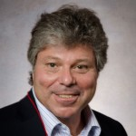
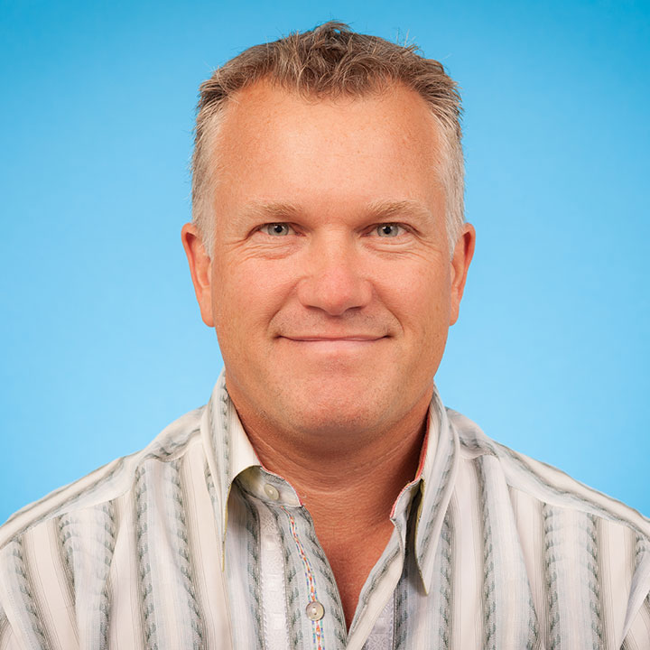
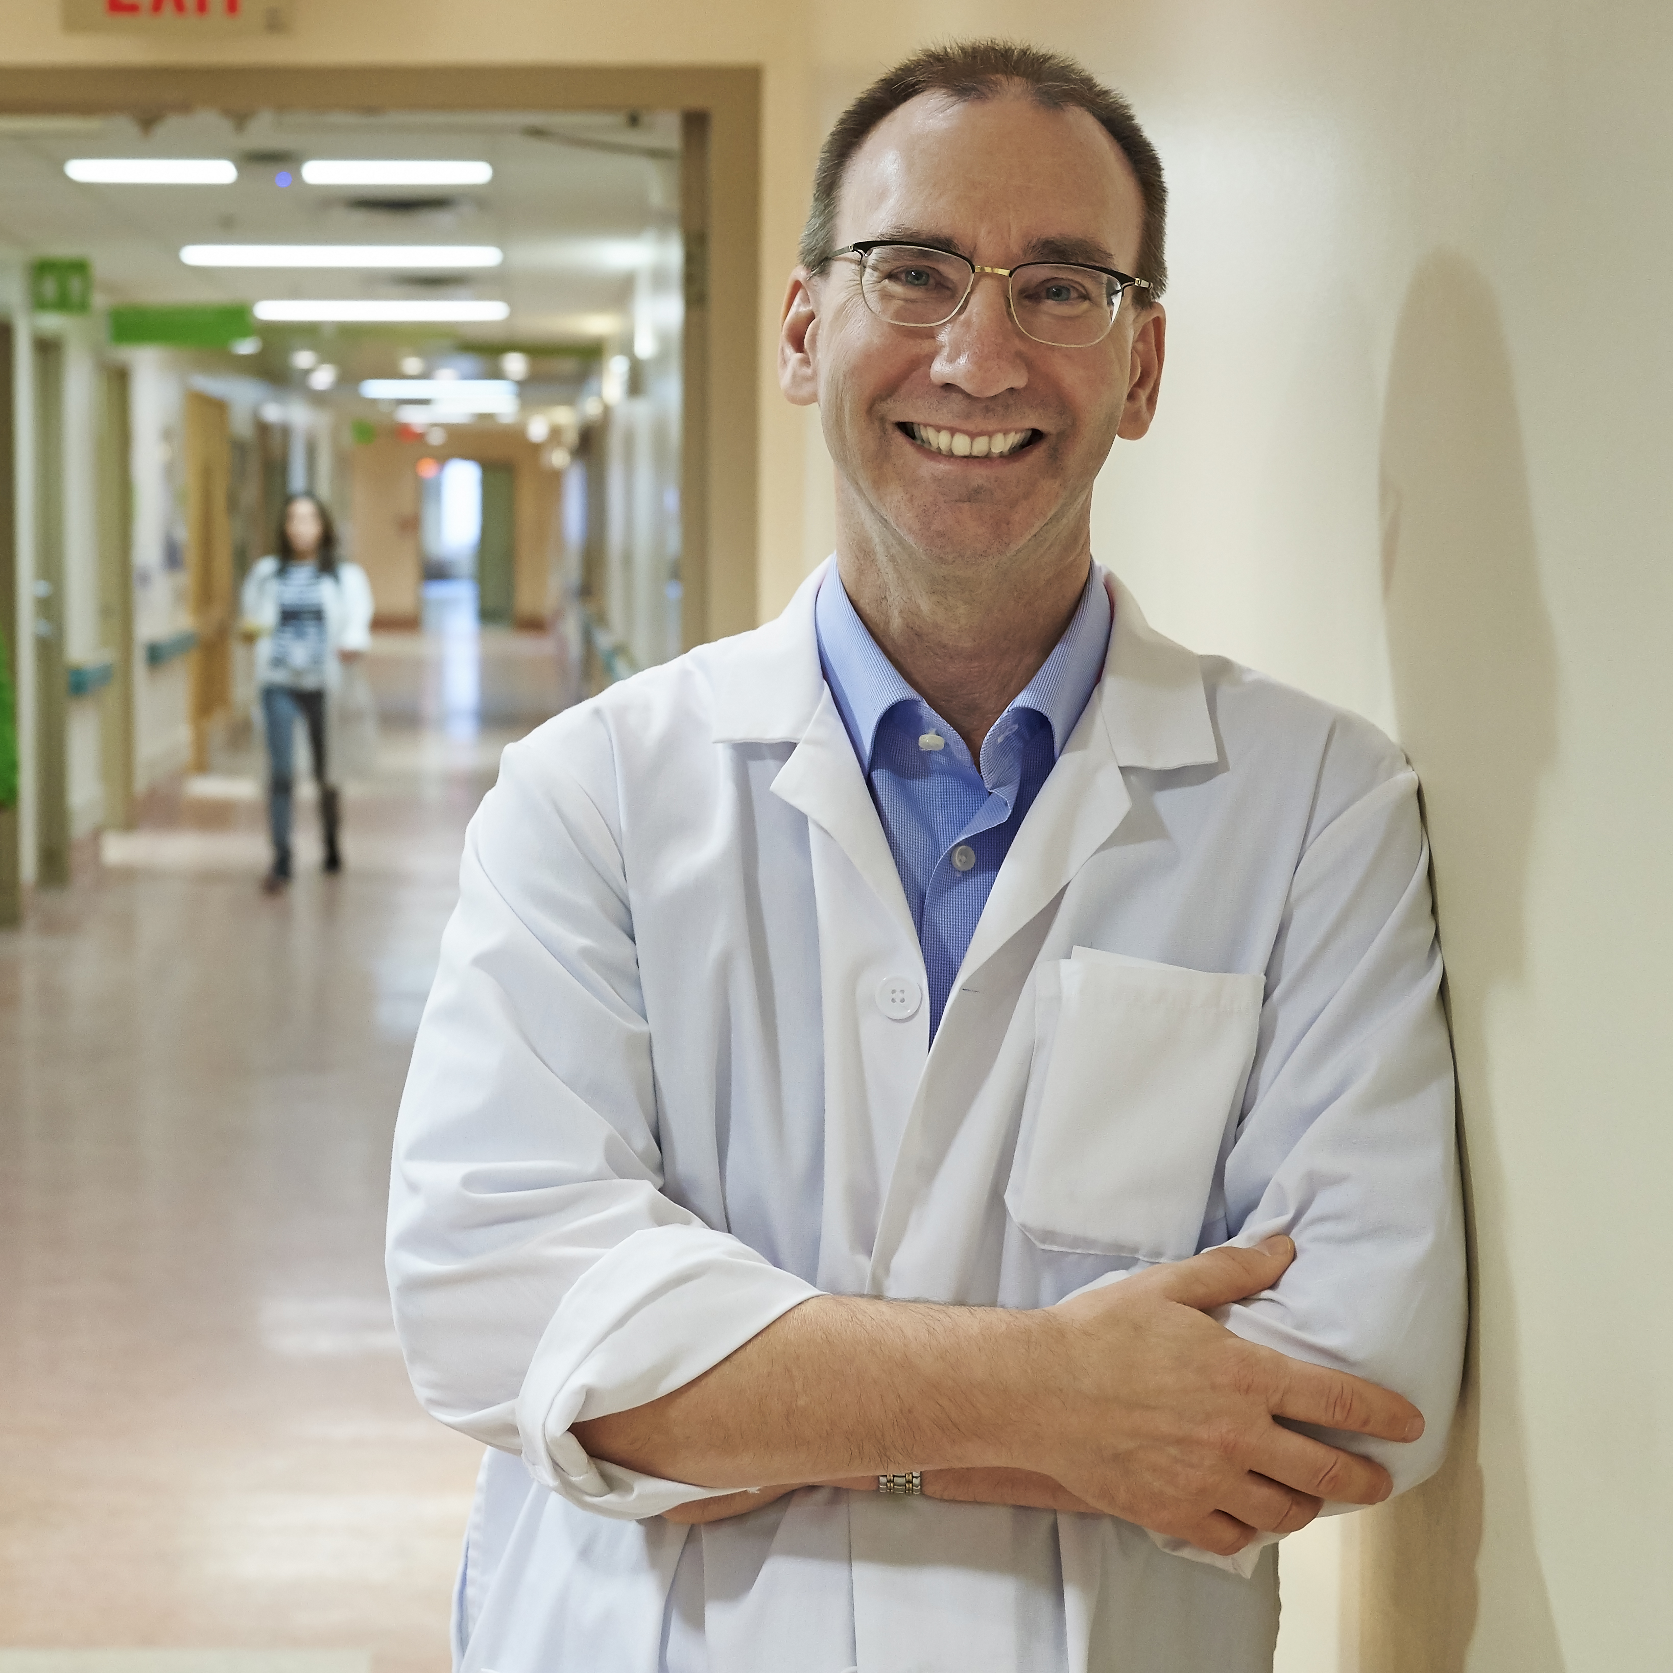
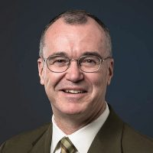
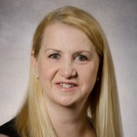
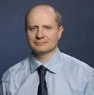
education & Research team 2018
Michael Fehlings
Vice Chair, Research
Najma Ahmed
Vice Chair, Education
Ralph George
Director, CPD
Ron Levine
Director, Postgraduate Education
Jeremy Hall
Director, Undergraduate Education
Robin Richards
Chair, Internal Evaluations Committee
Melinda Musgrave
Director, Education Evaluation
Oleg Safir
Director, Surgical Skills Center

Slide 8
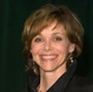
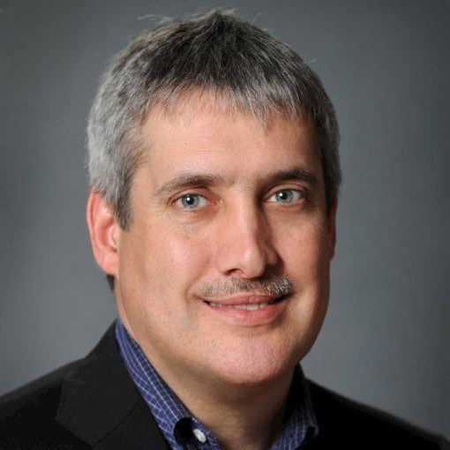
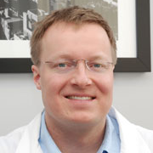
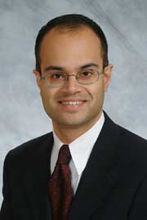
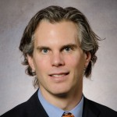
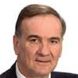
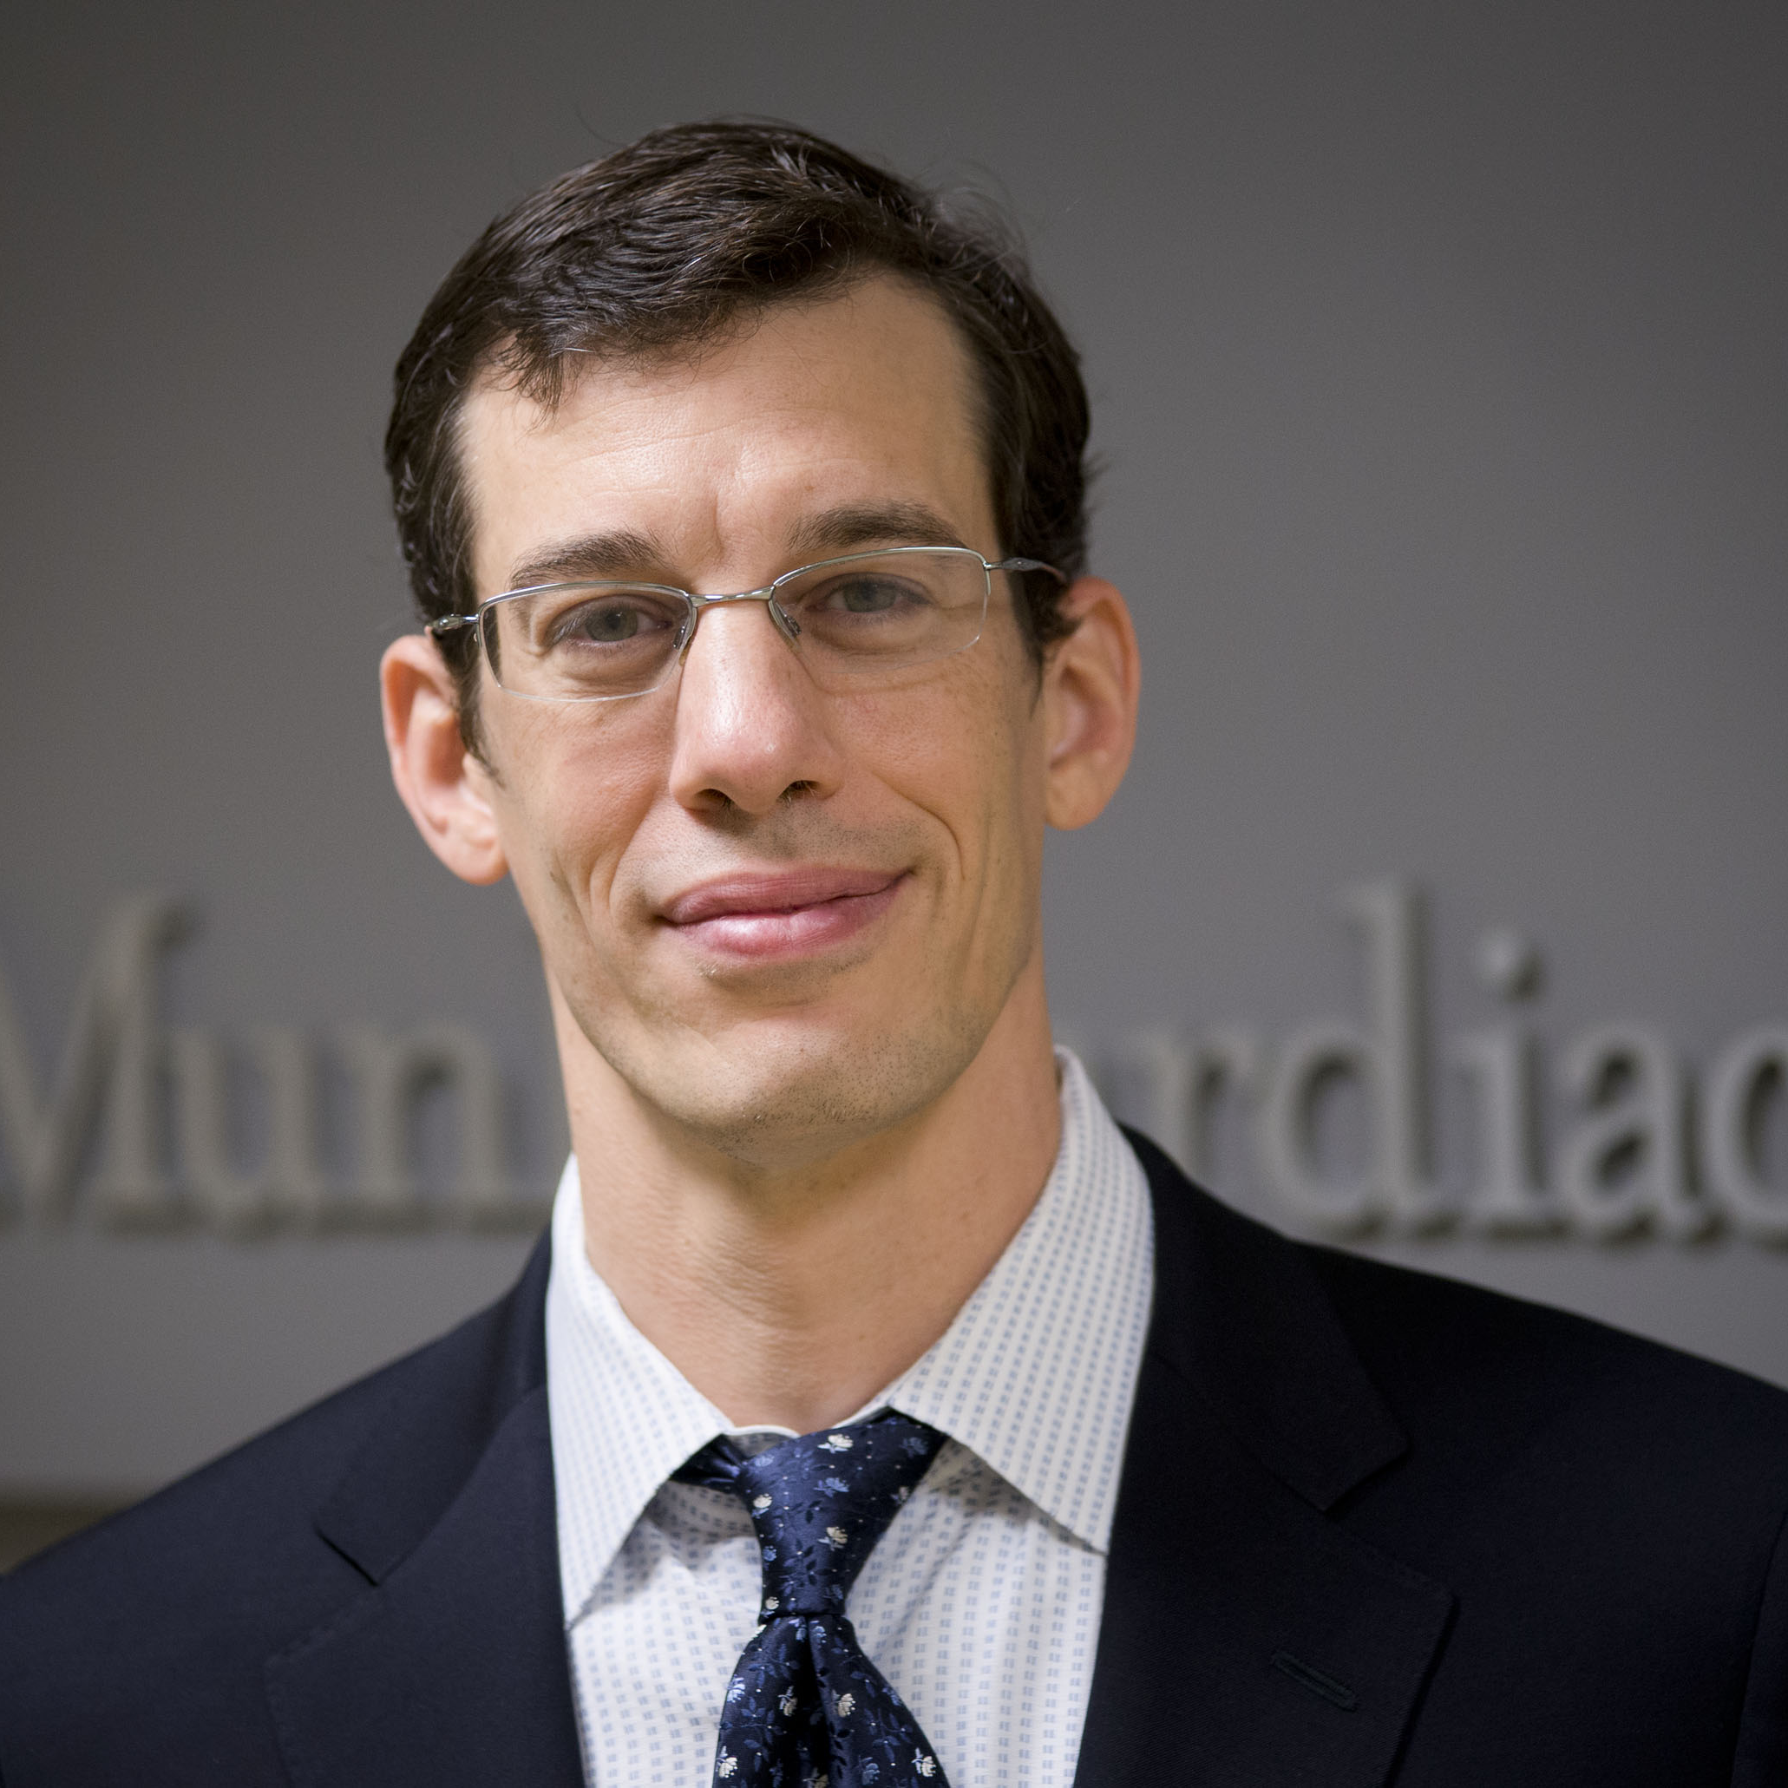
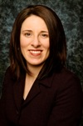
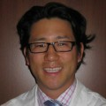
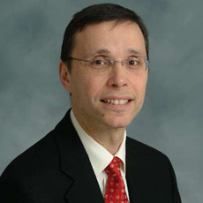
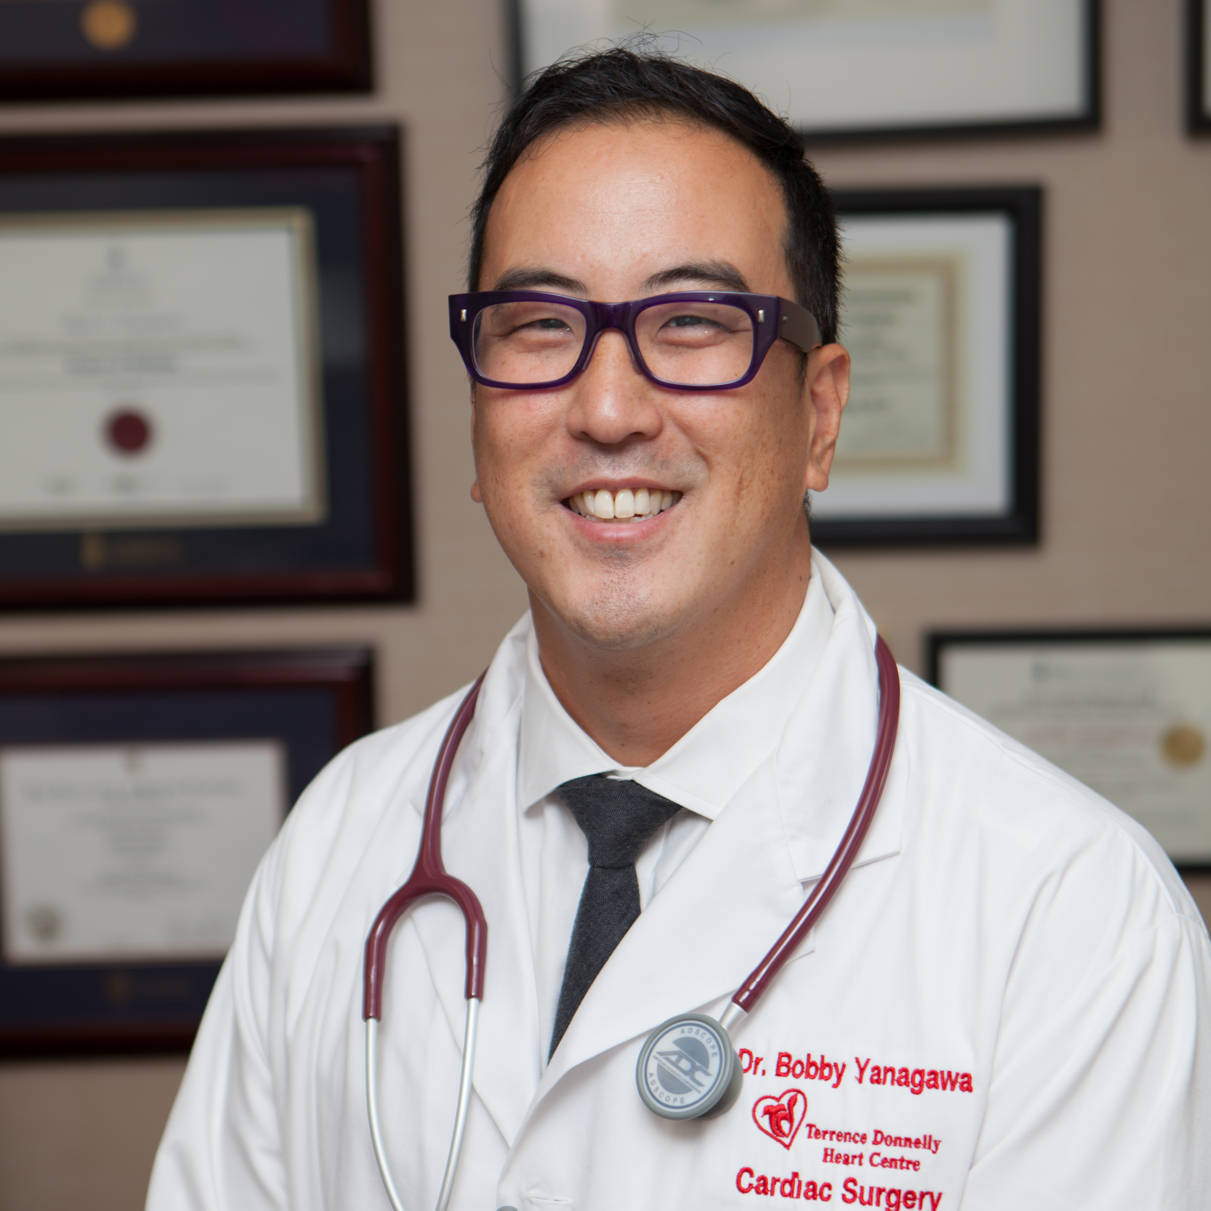
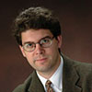
program directors 2018
Helen Macrae
Colorectal Surgery
Ab Kulkarni
Neurosurgery
Fred Brenneman
General Surgery
Markku Nousiainen
Orthopaedics
Kyle Wanzel
Plastic & Reconstructive Surgery
Agostino Pierro
Paediatric General Surgery
George Oreopoulos
Vascular Surgery
Frances Wright
Surgical Oncology
Andrew Pierre
Thoracic Surgery
Jason Lee
Urology
R J Cusimano
Cardiac Surgery
Bobby Yanagawa
Cardiac Surgery

Slide 9
New leadership positions
Elisa Greco - Associate Director, Undergraduate Education [Surgery]
Jeff Fialkov - Hospital Head, Plastic & Reconstructive Surgery [Sunnybrook Health Sciences Centre]
Tom Forbes - Hospital Head, Vascular Surgery [University Health Network]
Andrew Howard - Interim Hospital Head, Orthopaedics [Hospital for Sick Children]
Paul Karanicolas - Medical and Scientific Co-Director for Clinical Trial Services [Sunnybrook]
Alice Wei - Regional Director for Surgical Oncology
Lorraine Tremblay - President Trauma Association of Canada
Simon Kelley - Deputy Editor for Hip and Lower Limb Surgery, Journal of Paediatric Orthopaedics
Steve McCabe - International Society of Vascularized Composite Allotransplantation Board of Directors
Gelareh Zadeh - Vice President Society of Neuro-oncology

Slide 10
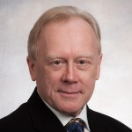
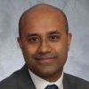
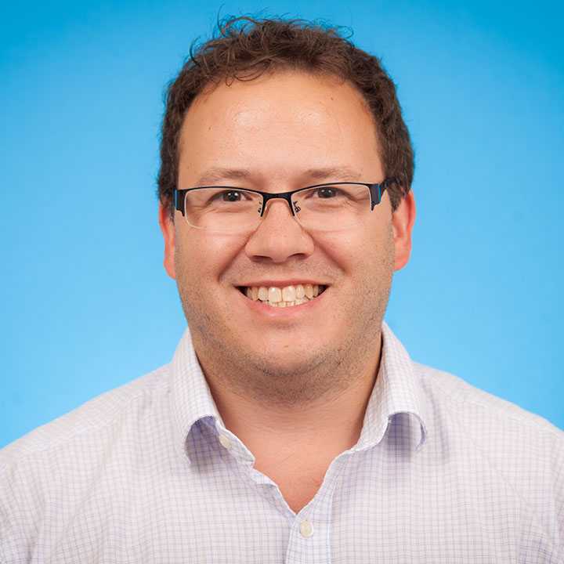
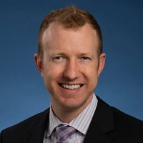
Academic promotions July 1, 2017 - June 30, 2018
Assistant to Associate
Sunit Das
St. Michael’s Hospital
Neurosurgery
Greg Fairn
St. Michael’s Hospital
General Surgery
Robert Hamilton
University Health Network
Urology

Slide 11
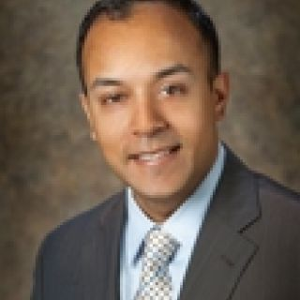
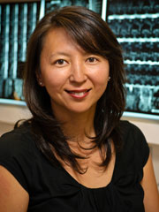
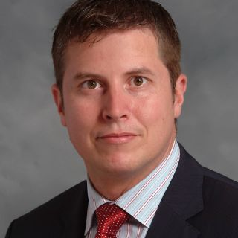
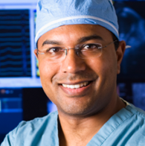
Academic promotions July 1, 2017 - June 30, 2018
ASSISTANT TO ASSOCIATE cont’d
Shiva Jayaraman
St. Joseph’s Health Centre
General Surgery
Diane Nam
Sunnybrook Health Sciences Centre
Orthopaedics
Bernard Lawless
St. Michael’s Hospital
General Surgery
Atul Verma
Southlake Regional Health Centre
Vascular Surgery

Slide 12
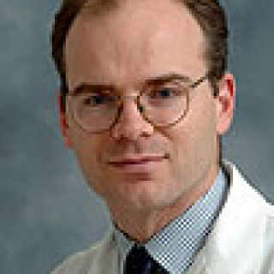
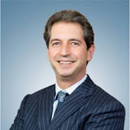
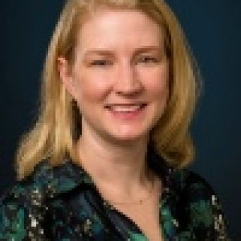
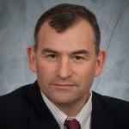
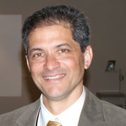
Academic promotions July 1, 2017 - June 30, 2018
ASSOCIATE TO FULL PROFESSOR
Marc de Perrot
University Health Network
Thoracic Surgery
Mitchell Brown
Women’s College Hospital
Plastic & Reconstructive Surgery
Natalie Coburn
Sunnybrook Health Sciences Centre
General Surgery
Unni Narayanan
Hospital for Sick Children
Orthopaedics
David Fisher
Hospital for Sick Children
Plastic & Reconstructive Surgery

Slide 13
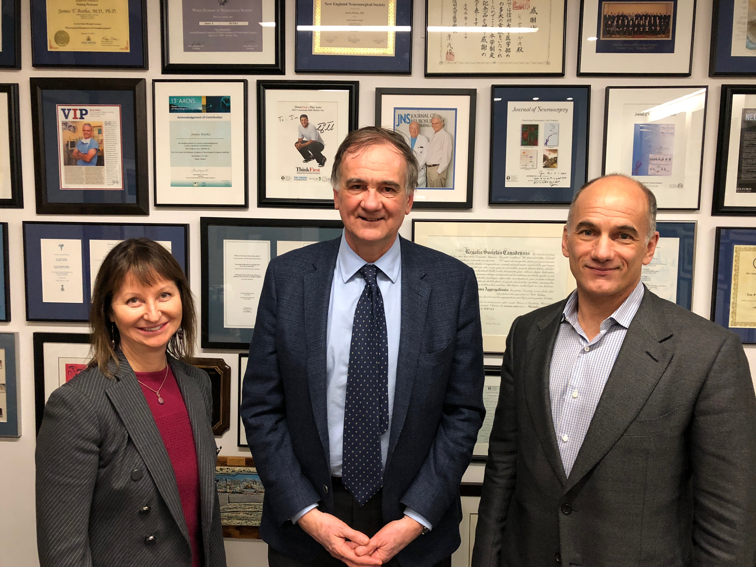
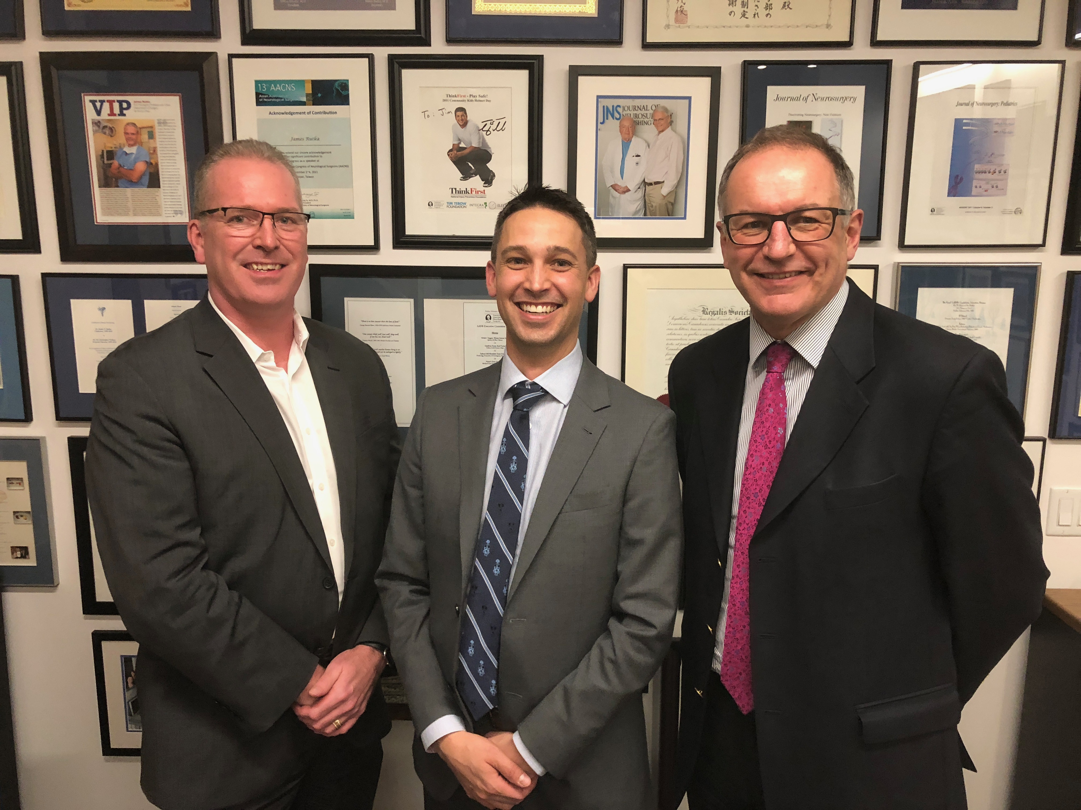
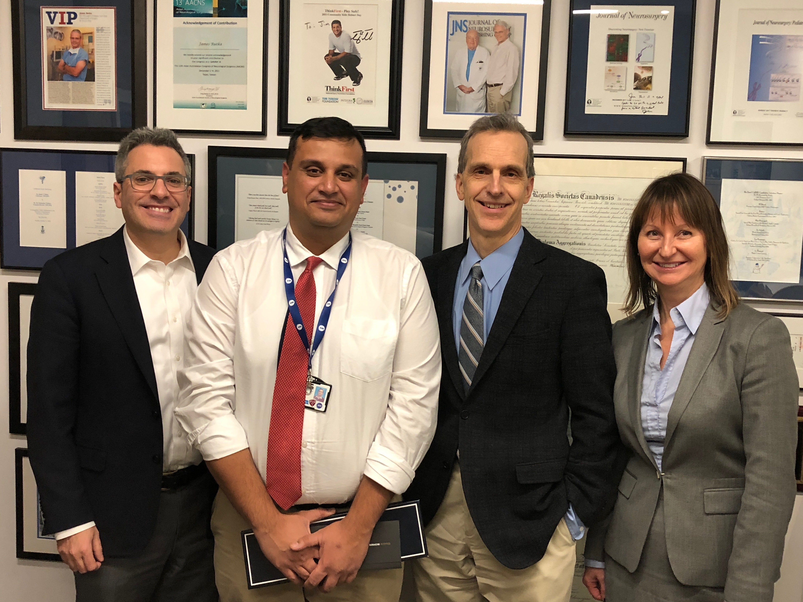
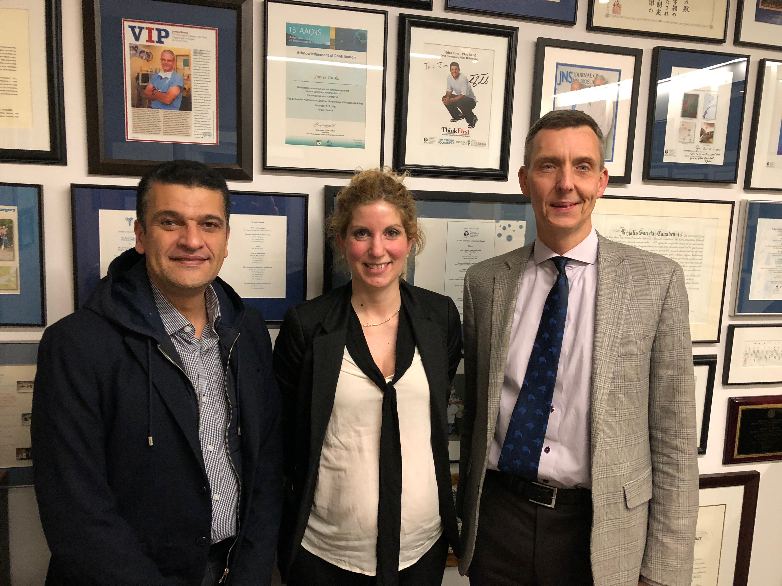
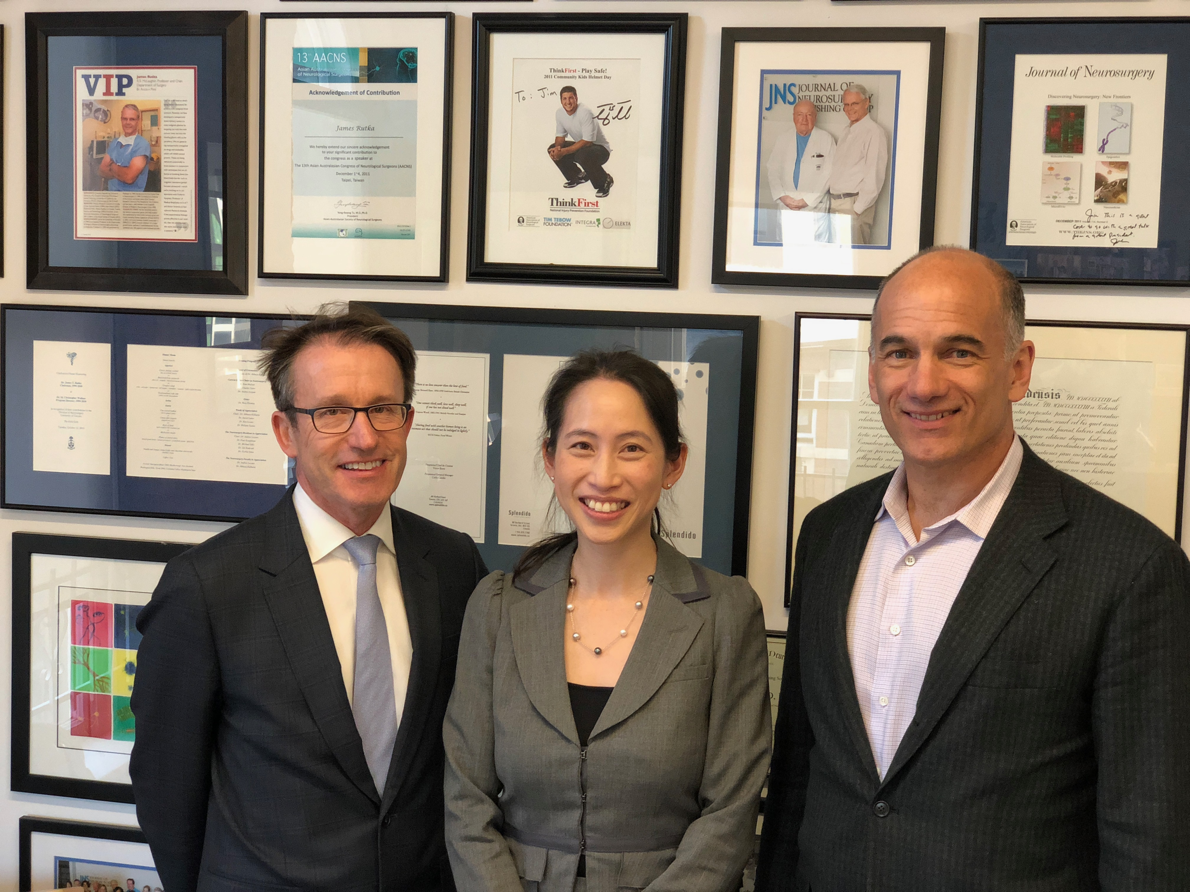
Continuing appointment reviews July 1, 2017 - June 30, 2018
Mark Camp
Agostino Pietro
Junaid Bhatti
Elisa Greco
Karen Wong

Slide 14
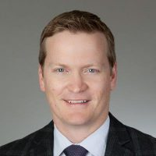
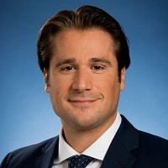
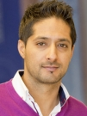
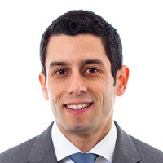
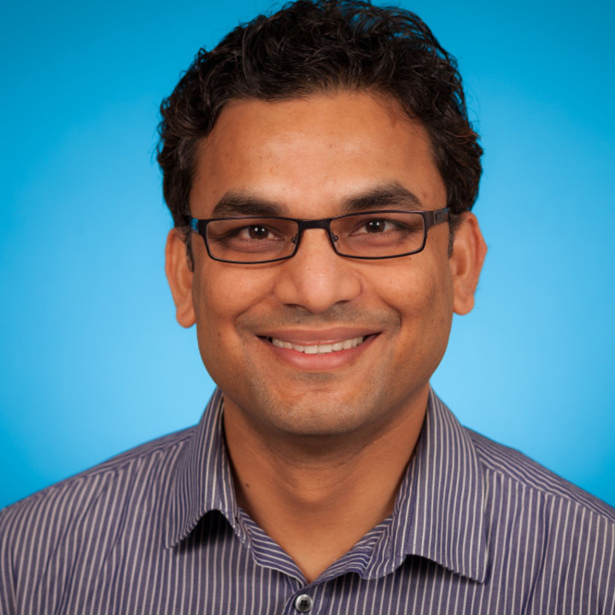
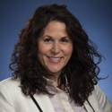
Continuing appointment reviews July 1, 2017 - June 30, 2018
Dean Elterman
University Health Network
Urology
Tim Dwyer
Women’s College Hospital
Orthopaedics
Mohit Kapoor
University Health Network
Orthopaedics
Michael Ordon
St. Michael’s Hospital
Urology
Krishna Singh
St. Michael’s Hospital
Vascular Surgery
Adena Scheer
St. Michael’s Hospital
General Surgery

Slide 15
New Faculty recruits July 1, 2017 - June 30, 2018
Adjunct Kaes Al-Ali (General Surgery)
Claude Burul (General Surgery)
Wayne Carman (Plastic & Reconstructive Surgery)
Michael Dan
Stacy O’Blenes (Cardiac Surgery)
Ato Sekyi-Otu (Orthopaedics)
Linda Wright
Part Time Harith Abbas (Orthopaedics)
Shafqat Ahmed (Cardiac Surgery)
Herman Dhotar (Orthopaedics)
Yasser El-Sheikh (Plastic & Reconstructive Surgery)
Mary Helen Mahoney (Plastic & Reconstructive Surgery)
Sharon Kim (Plastic & Reconstructive Surgery)
Melanie Tsang (General Surgery)

Slide 16
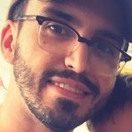
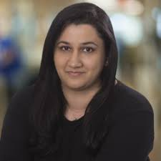
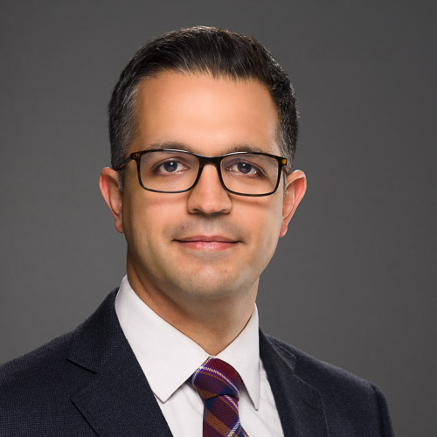
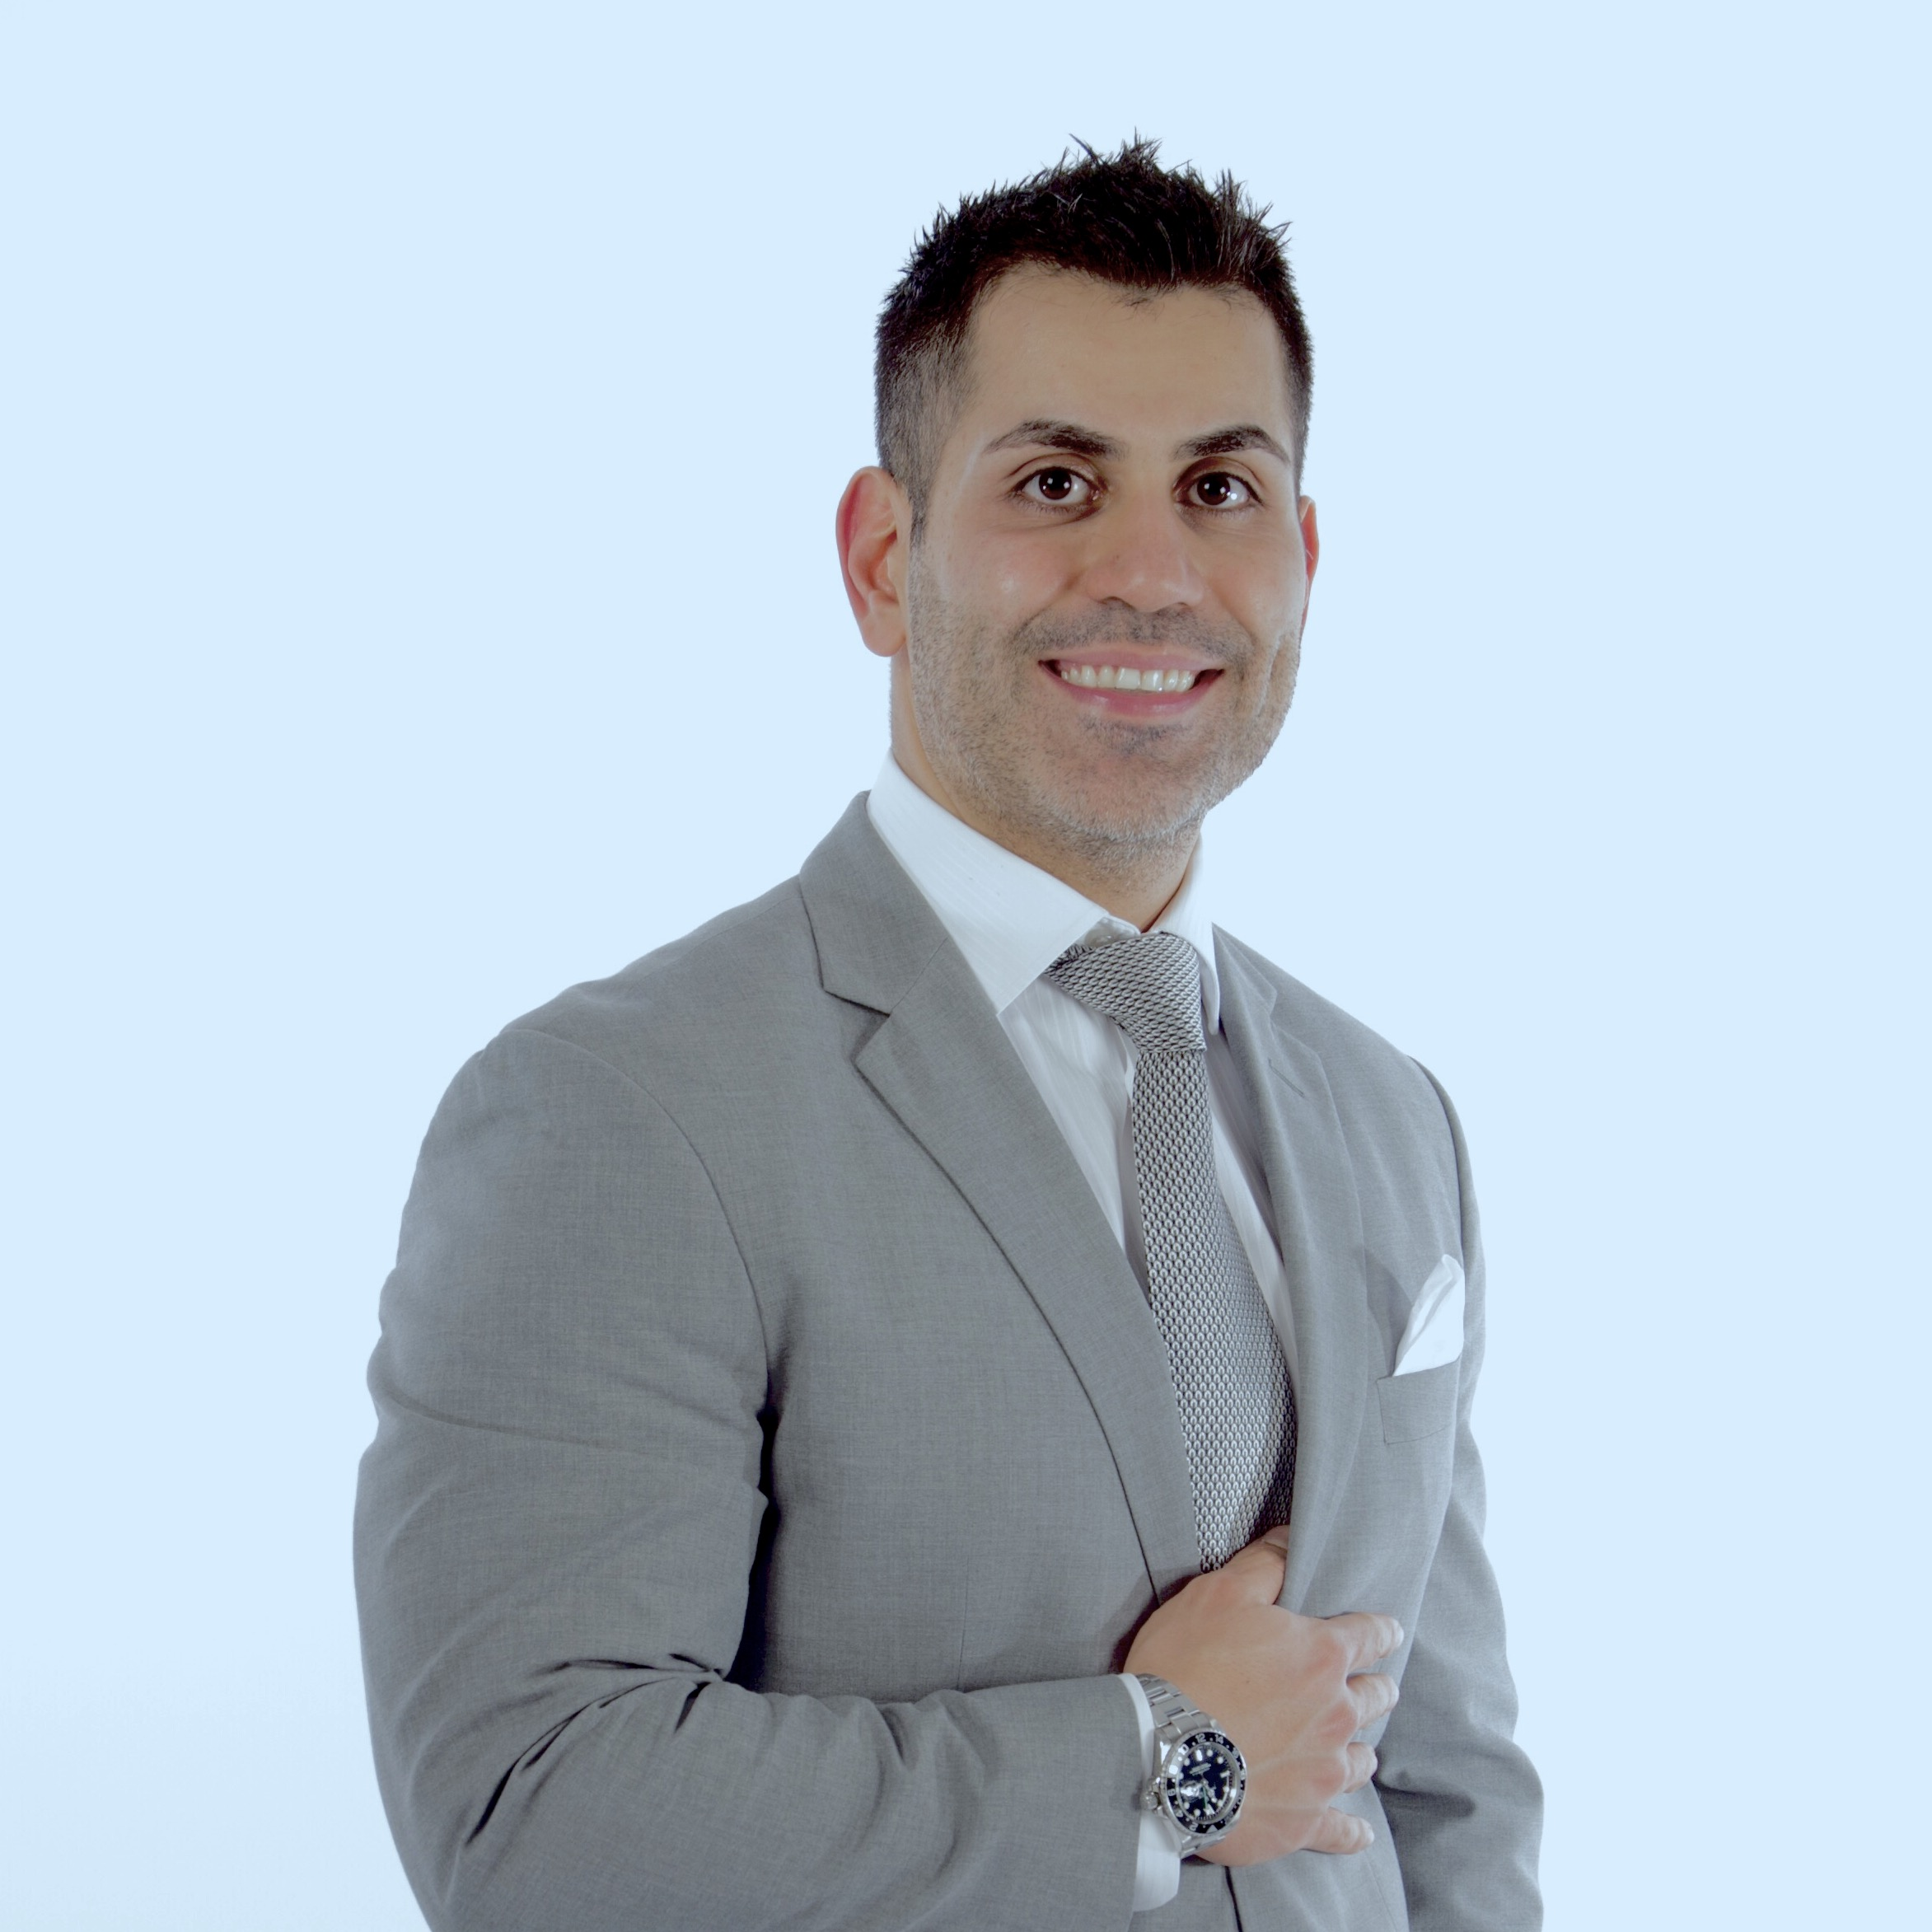
New Full time faculty recruits
David Gomez Jaramillo
General Surgery (SMH)
Preeti Dhar
General Surgery (UHN)
Ahmed Kayssi
Vascular Surgery (SHSC)
Amir Khoshbin
Orthopaedics (SMH)
Nathan Perlis
Urology (UHN)
Michael Zywiel
Orthopaedics (UHN)

Slide 17
New Full time faculty recruits
Anthony de Buck Van Overstaeten
General Surgery (MSH)
Charles de Mestral
Vascular Surgery (SMH)
George Ibrahim
Neurosurgery (HSC)
Siba Haykal
Plastic & Reconstructive Surgery (UHN)
Jesse Pasternak
General Surgery (UHN)
Yonah Krakowsky
Urology (WCH)
Mentors: Mohammed Al-Omran, Earl Bogoch, Rajiv Ghandi,
Timothy Jackson, Erin Kennedy, Joao Rezende-Neto,
Lorne Rotstein, Michael Taylor, David Urbach, Alice Wei

Slide 18
ADVANCEMENT
July 1, 2017 - June 30, 2018
$4,288,542 secured in donations in 2017-2018
Continue to expand our network of faculty collaborators
Secured $1.55M from John Ross and Patricia Quigley for the Chair in Limb Preservation in Vascular Surgery
Secured $250K gift from former Department of Surgery Chair John Wedge and his wife Patty Rigby for SSTP, expanding their commitment to the University and support of Post Grad scholarship
Hosted a stewardship event for A. K. Prakash and over 40 individuals of significant influence to celebrate the phenomenal contribution of the Prakash Foundation, and the achievements of all the seven fellows who were in attendance and visiting from Ethiopia, Kenya, Nigeria, Zimbabwe, and Trinidad & Tobago, where they have all gone back to practice

Slide 19
ADVANCEMENT
July 1, 2017 - June 30, 2018

Slide 20
Departures
University of Toronto Department of Surgery
Annual Address 2018
Chris Caldarone
Texas Childrens Hospital
Glen Van Arsdell
UCLA
Ted Gerstle
Memorial Sloan Kettering
Martin Gargan
Bristol
Mike McKee
Phoenix
Sean Cleary
Mayo Clinic

Slide 21
University of Toronto Department of Surgery
Other departures worth noting
Annual Address 2018
Dr Peter Pisters
CEO, UHN
Dr Mike Apkon
CEO, Sick Kids
Dr Robert Howard
CEO, St Michael’s
Dr Robert Bell
Deputy Minister
MOHLTC

Slide 22
University of Toronto Department of Surgery
Annual Address 2018
IN MEMORIAM
Dr. Martin Barkin
Division of Urology
1936 - 2018

Slide 23
CHAIR ANNOUNCEMENTS
July 1, 2017 - June 30, 2018
Soham & Shaila Ajmera Family Chair in Urologic Oncology Research
Robert Nam (re-appointed)
Kress Family Chair in Esophageal Cancer
Gail Darling (re-appointed)
Feldberg Chair
in Spinal Research
Joel Finkelstein
R. Fraser Elliott Chair
in Vascular Surgery
Tom Forbes
Keenan Chair in Surgery
Teodor Grantcharov
J. Ross & Patricia Quigley Chair
in Limb Preservation
Giuseppe Papia

Slide 24
University of Toronto Department of Surgery
Annual Address 2018
HONOURS AND AWARDS July 1, 2017 - June 30, 2018
Shady Ashamalla
Ivan Silver Innovation Award
Jameel Ali
Dr. Charles Burns TAC Board Recognition
Michael Dan
Doctor of Laws - University of Toronto
John Byrne
Wylie Scholarship Award
Kristen Davidge
Plastic & Reconstructive Surgery Early Career Award
Tirone David
Honorary Member of the Royal College of Surgeons of Edinburgh

Slide 25
University of Toronto Department of Surgery
Annual Address 2018
HONOURS AND AWARDS cont’d JULY 1, 2017 - JUNE 30, 2018
Sandra de Montbrun
David Fear Fellowship
PGME Development and Innovation Award
Dennis Di Pasquale
Excellence in Community-based Teaching Award (Clinical Office)
Jaime Escallon
Frank Mills Teaching Award
James Drake
Lifetime Achievement - International Federation of Neuroendoscopy Award
Sender Herschorn
International Continence Society Lifetime Achievement Award
Michael Fehlings
David Lostchuck Memorial Award
German Ochoa Traveling Fellowship

Slide 26
University of Toronto Department of Surgery
Annual Address 2018
HONOURS AND AWARDS cont’d JULY 1, 2017 - JUNE 30, 2018
Laurence Klotz
Dean’s Alumni Lifetime Achievement Award
Abhaya Kulkarni
PGME Teaching Performance, Mentorship and Advocacy Award
Bernard Langer
AHPBA 2018 Nonie Lowry Distinguished Service Award
Tom Lindsay
Residents and Fellows Most Outstanding Faculty Member Award
Joan Lipa
William K. Lindsay Faculty Research Mentor Award
Steve McCabe
Plastic & Reconstructive Surgery Above and Beyond Award
Arnis Freiberg Award
Fuad Moussa
Peters-Boyd Teaching Award

Slide 27
University of Toronto Department of Surgery
Annual Address 2018
HONOURS AND AWARDS cont’d JULY 1, 2017 - JUNE 30, 2018
Maral Ouzounian
Nina Braunwald Fellowship
Ori Rotstein
J J Berry Smith Doctoral Supervision Award
Subodh Verma
CRC Tier 1 Chair
John Semple
Adjunct Professor - OCAD University
Kyle Wanzel
Excellence in Community-based Teaching Award (Sustained Excellence)
Frances Wright
James IV Travelling Fellowship
ASA membership
Ronald Zuker
Dean’s Alumni Award - Lifetime Achievement (Global)

Slide 28
University of Toronto Department of Surgery
Annual Address 2018
GRANT Recipients July 1, 2017 - June 30, 2018
Greg Borschel
CIHR Project Grant
Nancy Baxter
Canadian Cancer Society
Nancy Baxter et al.
CIHR
Lesley Carr et al.
CIHR Project Grant
Chris Caldarone
Heart and Stroke Foundation
Natalie Coburn
CIHR Catalyst Grant
CIHR Operating Grant
Jas Chahal et al.
CIHR Project Grant

Slide 29
University of Toronto Department of Surgery
Annual Address 2018
GRANT RECIPIENTS JULY 1, 2017 - JUNE 30, 2018
Michael Cusimano
PSI Operating Grant
Marcelo Cypel
Canadian Cancer Society
CIHR Project Grant
Natalie Coburn and Savtaj Brar
CIHR
Karen Davis
CIHR Project Grant
Andrew Dueck
CIHR Project Grant
James Drake et. al
CIHR/NSERC

Slide 30
University of Toronto Department of Surgery
Annual Address 2018
GRANT RECIPIENTS JULY 1, 2017 - JUNE 30, 2018
James Eubanks
CIHR Project Grant
Greg Fairn
NSERC
Antonio Finelli
CIHR Catalyst Grant
Maryam Faiz
Connaught New Researcher Award
Tom Forbes
PSI Grant
Stephen Fremes
CIHR Project Grant

Slide 31
University of Toronto Department of Surgery
Annual Address 2018
GRANTS RECIPIENTS JULY 1, 2017 - JUNE 30, 2018
Anna Gagliardi
CIHR Project Grant
Rebecca Gladdy
McLaughlin Centre Accelerator Grant
David Grant
Heart and Stroke Foundation Grant
Anand Govindarajan
Innovation Funds in Surgical Oncology
Julie Hallett
SSAT Career Development Award
Barbara Haas
CIHR Bridging Grant

Slide 32
University of Toronto Department of Surgery
Annual Address 2018
GRANTS RECIPIENTS JULY 1, 2017 - JUNE 30, 2018
Mohit Kapoor
CIHR Project Grant #1
CIHR Project Grant #2
NSERC Discovery Grant
Krembil Research Institute Grant
Suneil Kalia
CIHR Project Grant
Paul Karanicolas
CIHR Bridging Grant
Andras Kapus
CIHR Project Grant
Erin Kennedy
CIHR Project Grant
Girish Kulkarni
CIHR Bridging Grant

Slide 33
University of Toronto Department of Surgery
Annual Address 2018
GRANTS RECIPIENTS JULY 1, 2017 - JUNE 30, 2018
Mingyao Liu
CIHR Project Grant
Cindi Morshead
NSERC Discovery Grant
Girish Kulkarni and Nathan Perlis
CIHR Project Grant
John Marshall
CIHR Project Grant
Carol-Anne Moulton
PSI Grant
Diane Nam
CIHR Bridging Grant

Slide 34
University of Toronto Department of Surgery
Annual Address 2018
GRANTS cont’d JULY 1, 2017 - JUNE 30, 2018
Ivan Radovanovic
McLaughlin Centre Accelerator Grant
Bheeshma Ravi
CIHR Catalyst Grant
Farhad Pirouzmand
CIHR Bridging Grant
Michael Reedijk
CIHR Project Grant #1
CIHR Project Grant #2
James Rutka
CIHR Operating Grant
CIHR Project Grant #1
CIHR Project Grant #2
John Semple
CIHR SPOR Grant
Plastic Surgery Foundation Grant
Jory Simpson
EDF Grant

Slide 35
University of Toronto Department of Surgery
Annual Address 2018
GRANTS cont’d JULY 1, 2017 - JUNE 30, 2018
Hong Sun
NSERC Discovery Grant
Krishna Singh
CIHR Project Grant
Heart and Stroke Foundation Grant
Michael Taylor
McLaughlin Centre Accelerator Grant
CIHR Project Grant #1
CIHR Project Grant #2
Katalin Szaszi
CIHR Bridging Grant
NSERC Discovery Grant
Michael Tymianski
Heart and Stroke Foundation Grant
Subodh Verma
CIHR Bridging Grant
CIHR Project Grant

